Slide 1
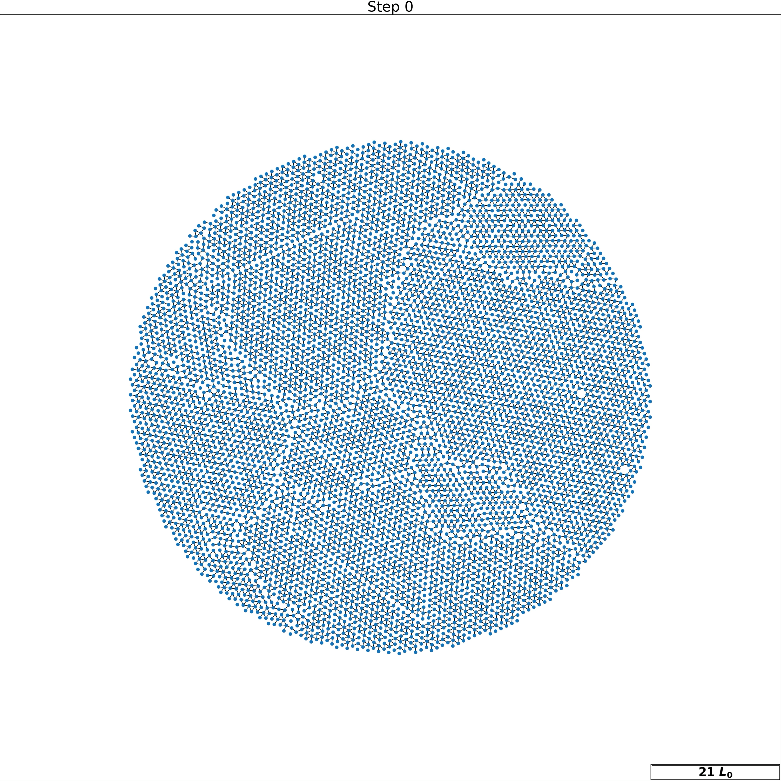
Random Spring Networks
Noah Toyonaga
12/5/22

Slide 2
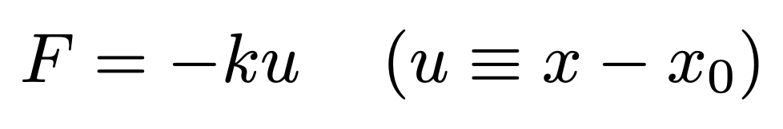
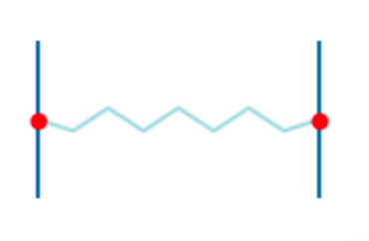
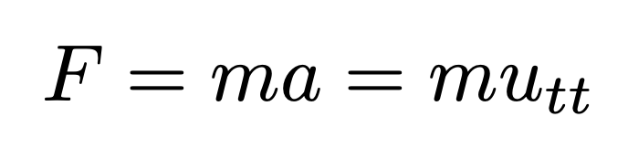
Motivation: “Classical” Spring Networks
Harmonic Spring Equation
Newton (Inertial Dynamics)

Slide 3
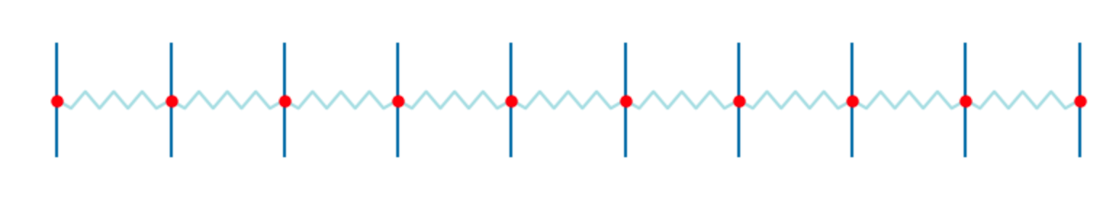
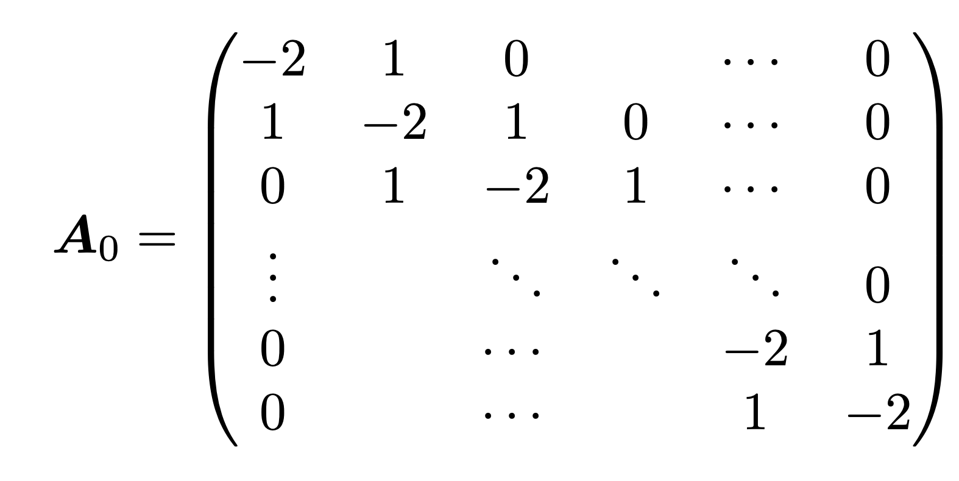
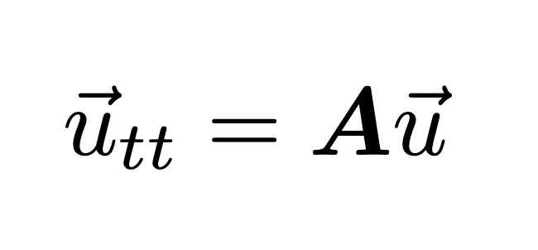
Motivation: “Classical” Spring Networks
Harmonic Spring Equation
Newton (Inertial Dynamics)
System of springs: stiffness Matrix

Slide 4
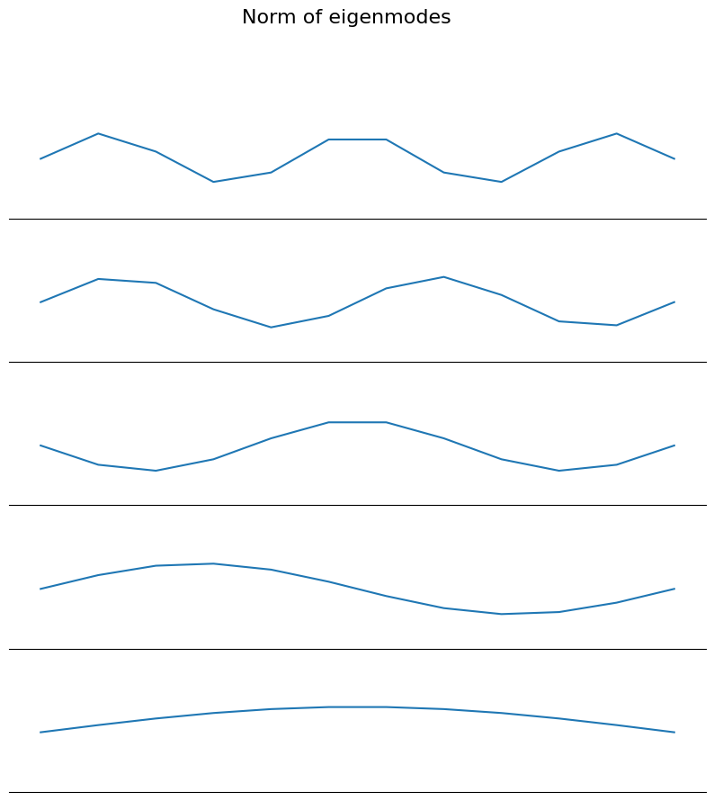
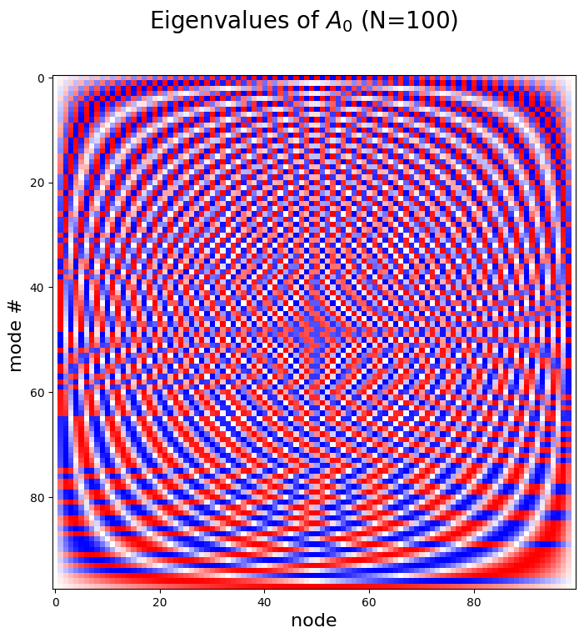
Modes of a 1D array of springs.
N = 10
N = 100

Slide 5
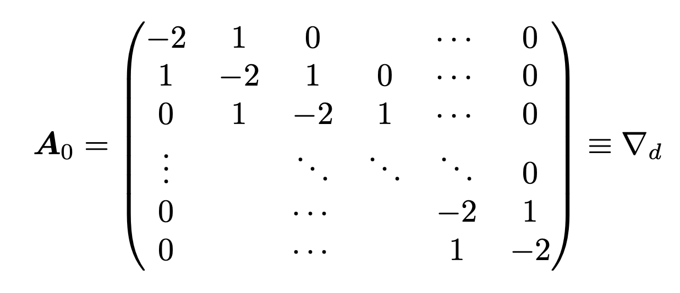
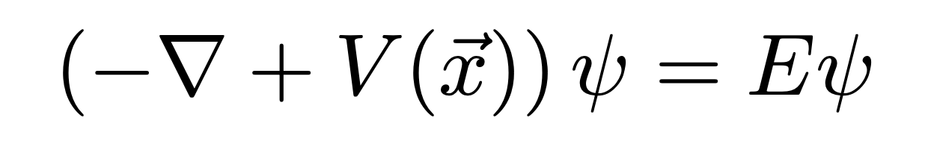
Poisson Equation
Finite Difference Operator
Time Independent Schrodinger Equation

Slide 6
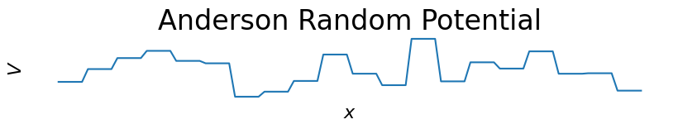
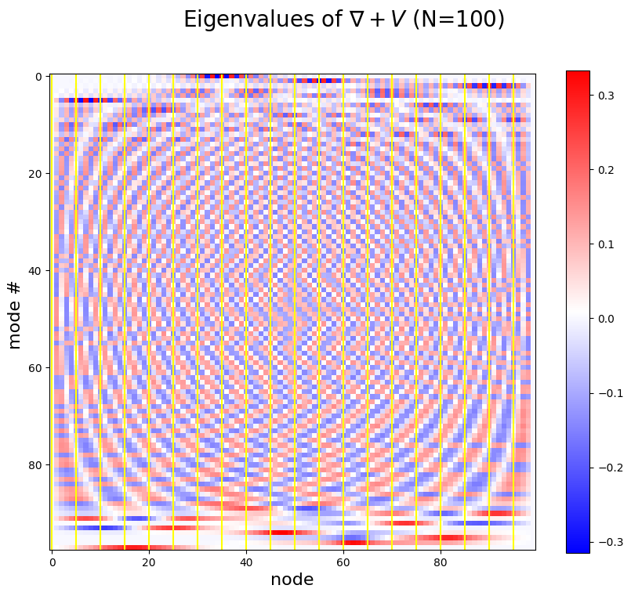
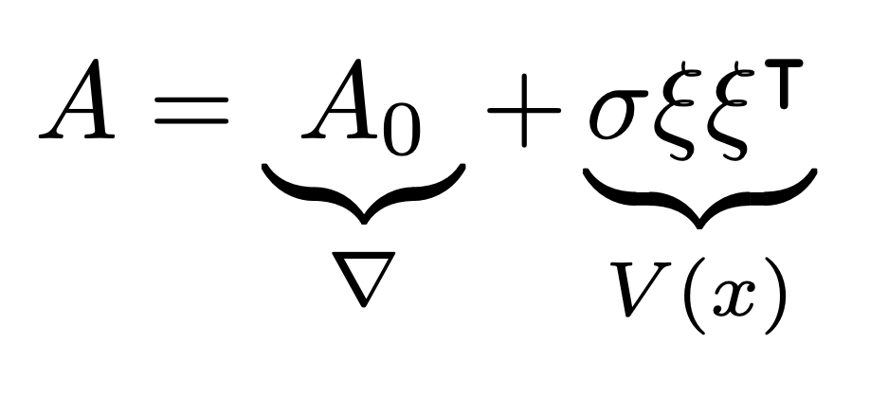
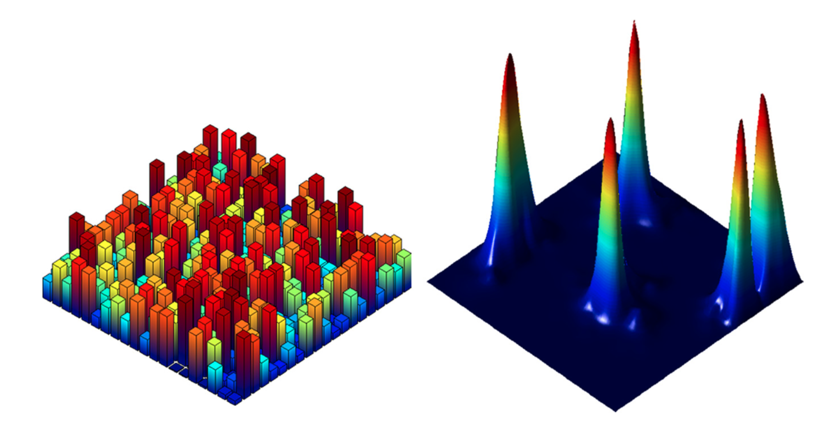
Anderson Localization
[1]
[1] M. Filoche and S. Mayboroda, Universal Mechanism for Anderson and Weak Localization, Proc. Natl. Acad. Sci. U. S. A. 109, 14761 (2012).
Notes:
random schrodinger operator

Slide 7
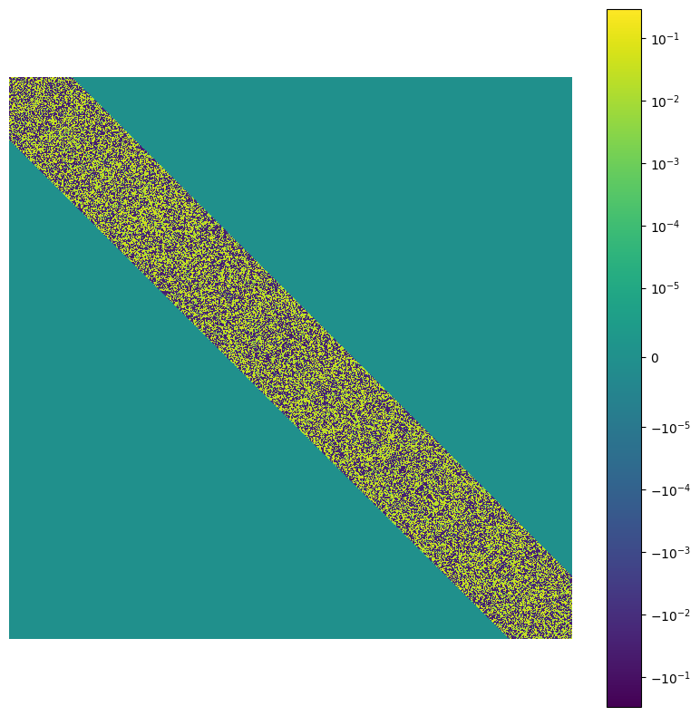
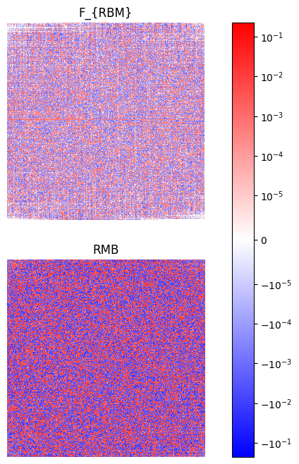
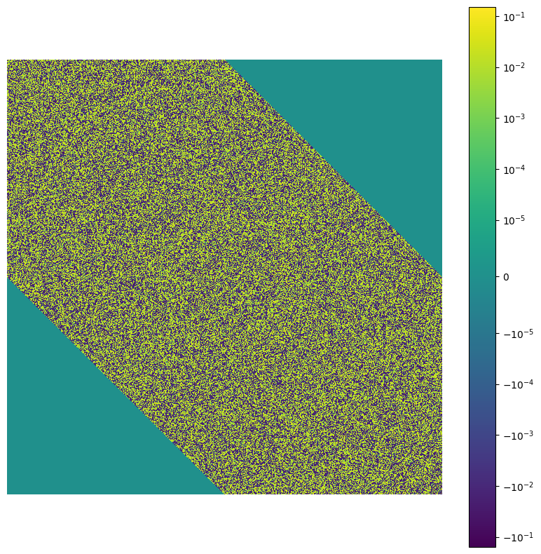
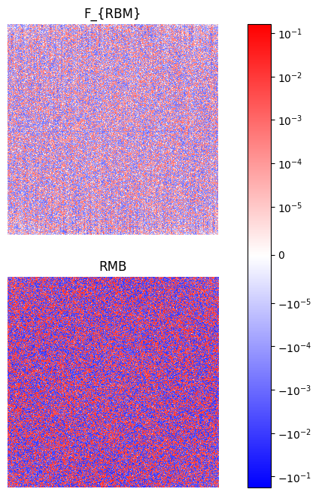
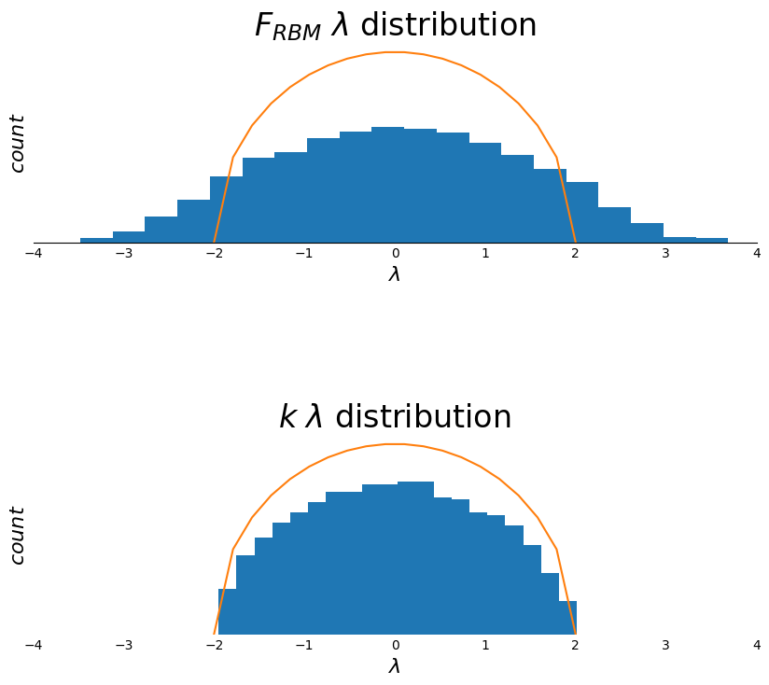
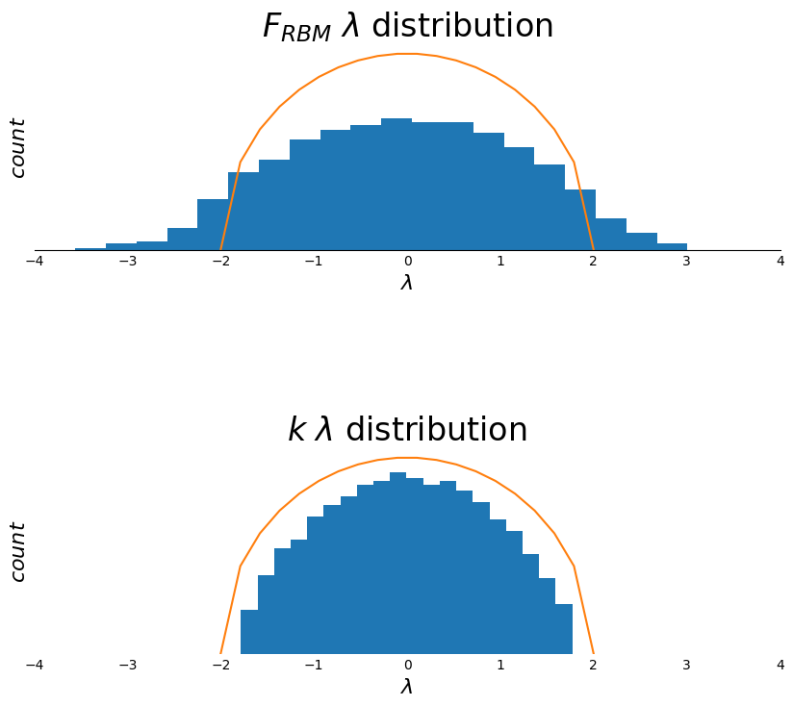
Random Band Matrices (RBM)
W = 450
W = 100
A
C
B
N=900
[1] P. Bourgade, Random Band Matrices, http://arxiv.org/abs/1807.03031.
[2] M. Shcherbina and T. Shcherbina, Universality for 1d Random Band Matrices, Commun. Math. Phys. 385, 667 (2021).

Slide 8
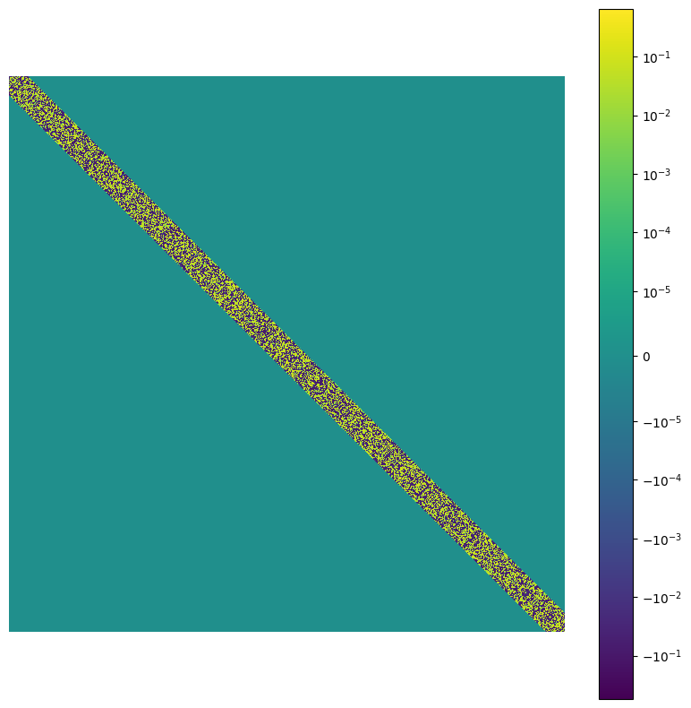
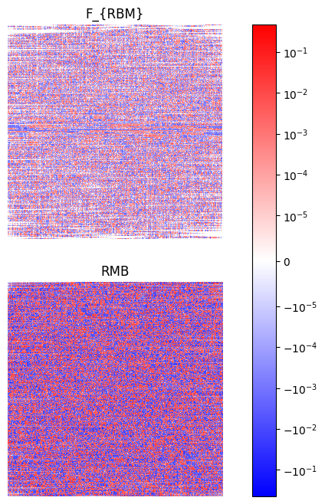
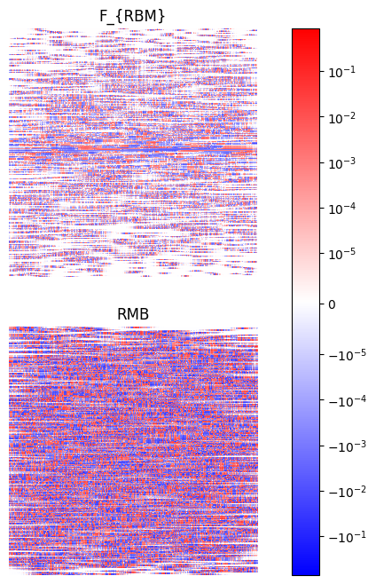
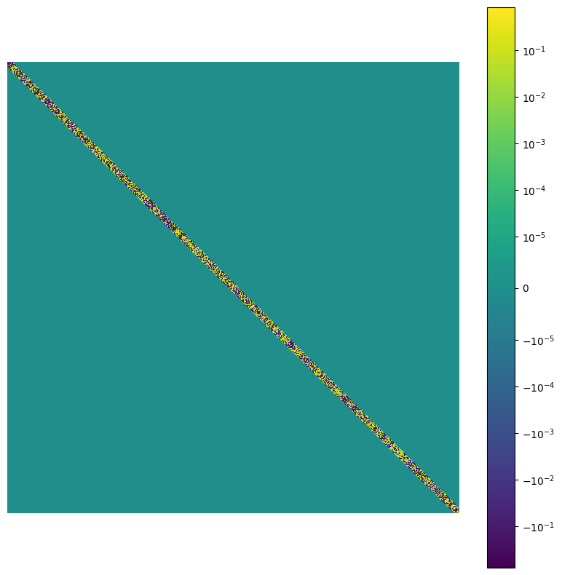
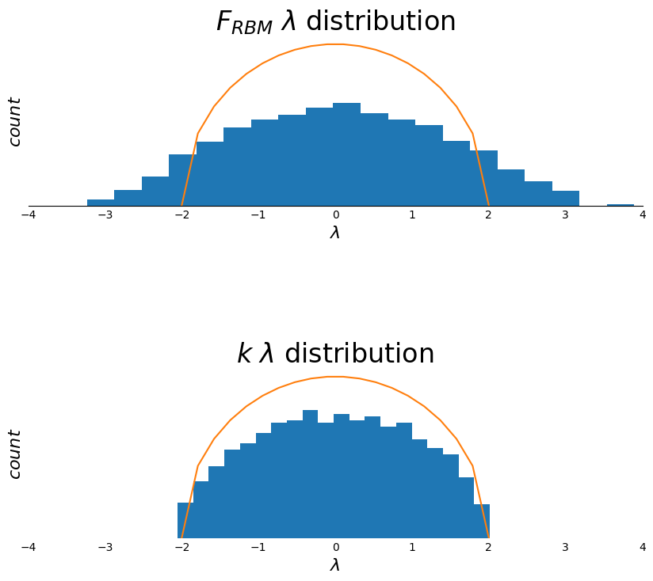
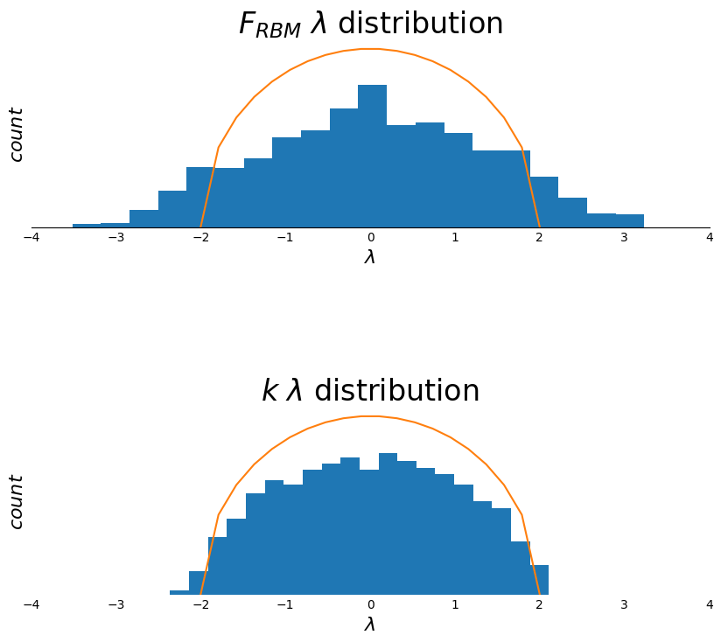
Random Band Matrices (RBM)
W = 30
W = 10
N=900

Slide 9
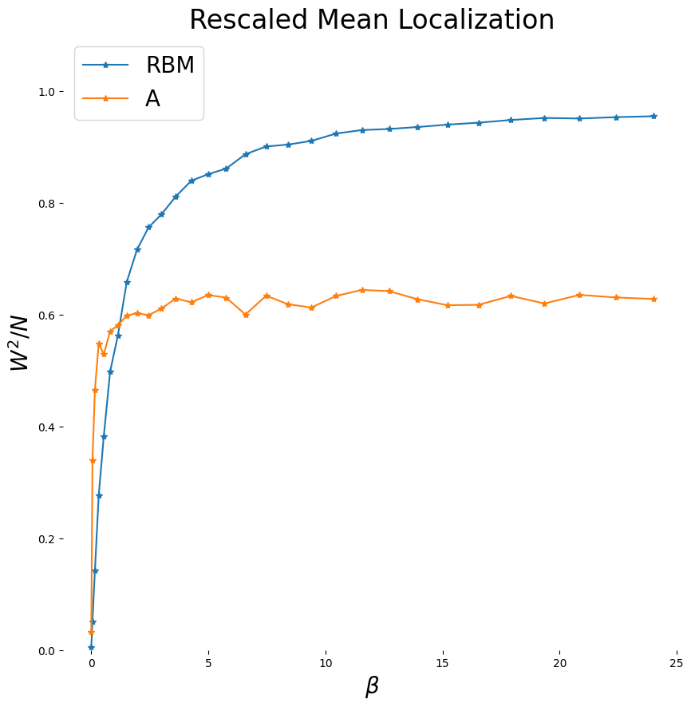
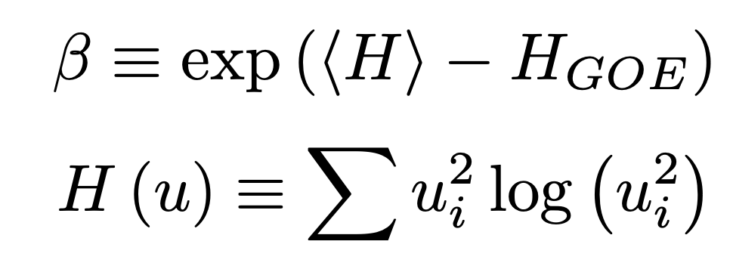
Random Band Matrices (RBM)
An order parameter for
eigenvector localization
N=900
[1] G. Casati, L. Molinari, and F. Izrailev, Scaling Properties of Band Random Matrices, Phys. Rev. Lett. 64, 1851 (1990).

Slide 10
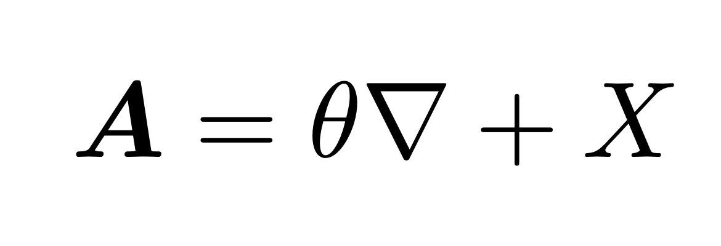
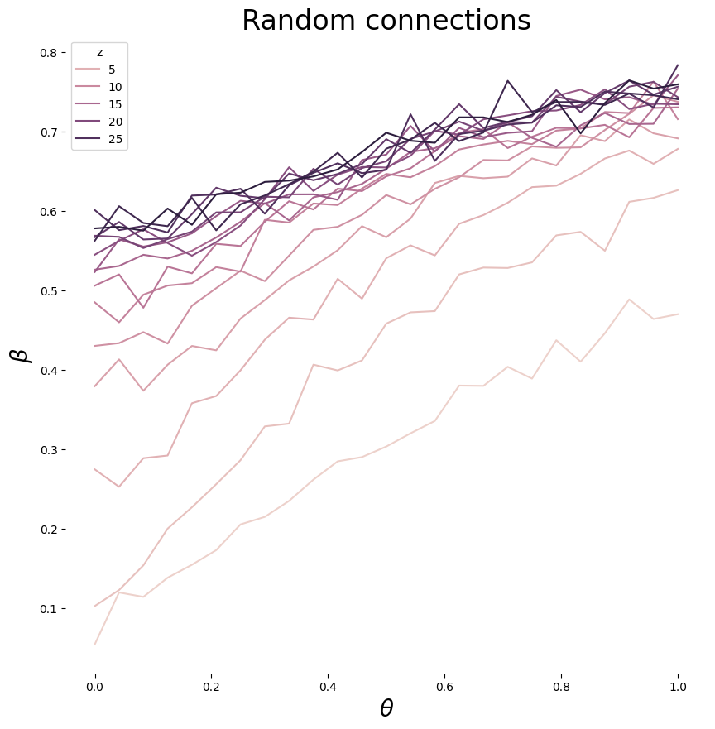
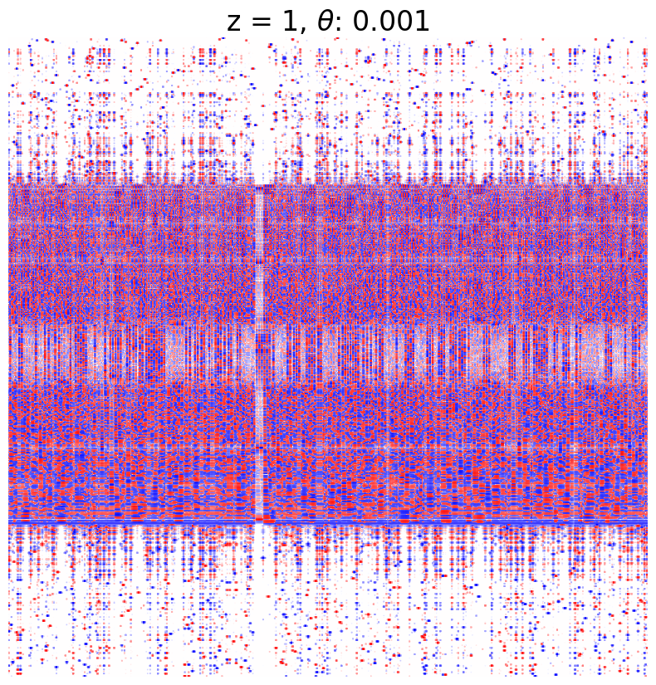
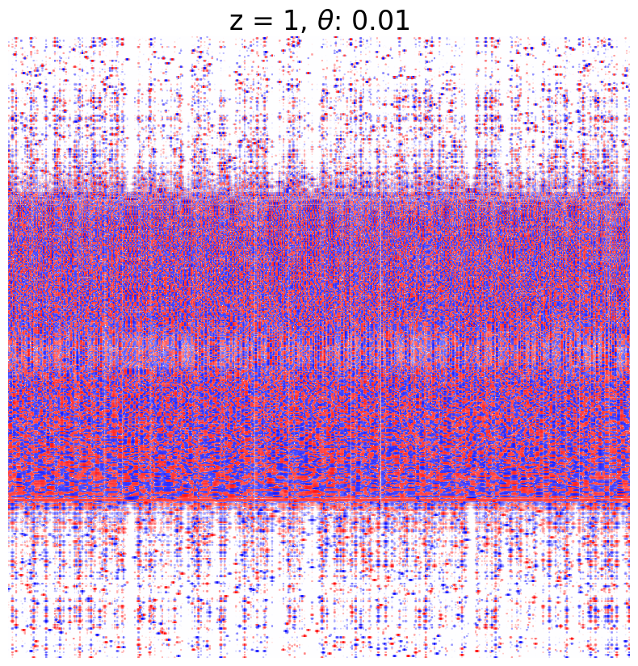
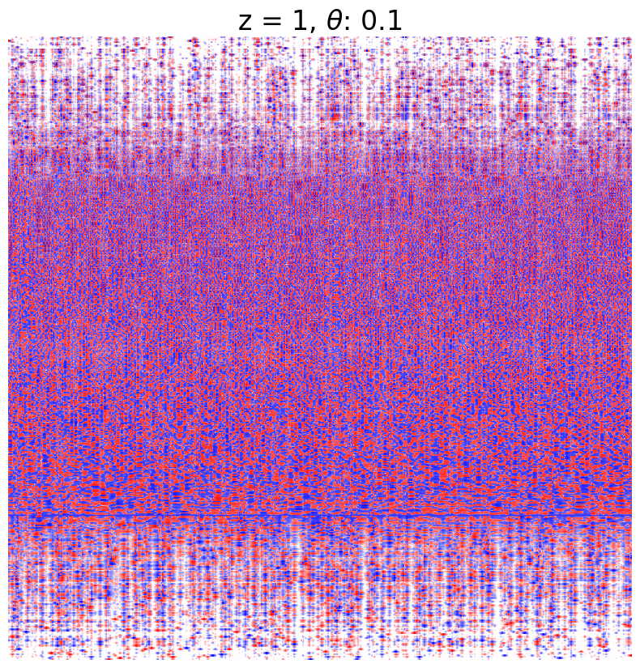
Poisson + Sparse Random Connections
N=500

